Slide 1
VISUAL C#.NET session 6
Instructor: Edwin oduor

Slide 2

Quote of the day

Slide 3
Lesson objectives
Working with Menus
Adding Sub Menus
Coding For Exit Button
Adding and Coding for Check box
Adding and Coding for Radio Button

Slide 4
Lesson pre-requisites
In order to take full advantage of this section you need to have the following;
Computer with Visual Studio Installed.
Stable Network Connection.

Slide 5
Training methods and extra readings
TRAINING METHODS FOR THIS LESSON
EXTRA READINGS
Lecturing Method – This is the main method of training to be adopted in this lesson with illustrations and practical coding examples.
Discussion Method - This method will be adopted periodically whereby learning will be derived principally from the students brainstorming together, rather than from the trainer. Three main types of discussions will be used:
Directed discussion
Developmental discussion
Problem-Solving discussion
Home and Learn C#

Slide 6
MENUS

Slide 7
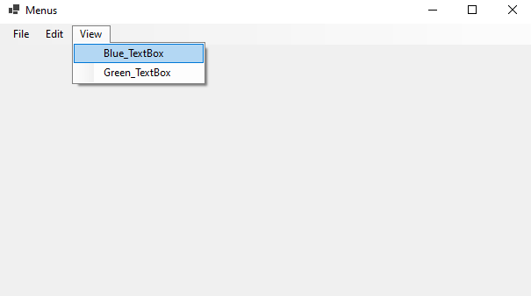
MENUS
In this lesson we are going to learn how to create menus, will be able to create menus as shown in the image above.

Slide 8
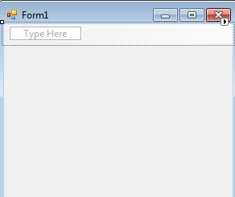
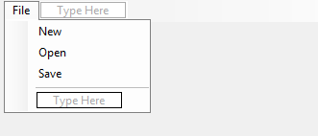
ADDING MENUS
To add menus in our project, will use the tool box, locate menus and tool bar section, double click on the menu strip, it will be added at the bottom of the form. The moment you have added menu strip you will see this. You have type here, that’s where one types the name of the menu.
Once you type the first menu, one is still able to add more as shown below.

Slide 9
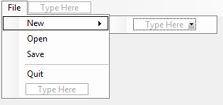
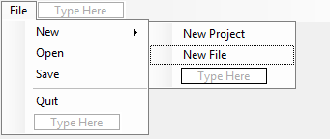
Adding a sub menu
Click on type here and type the name of the menu to add a sub menu

Slide 10
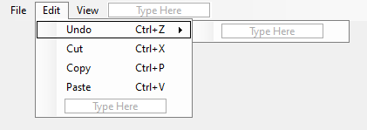
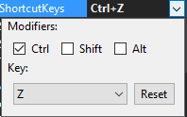
Menu short cuts
Click on the menu that you want to add the short cuts then go to the properties window, scroll down to shortcut keys. Click on the short cut keys, click on the drop-down button then select the keys that you want to use for the selected menu.

Slide 11
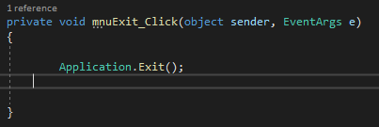
Coding for the exit button
When the Exit button is clicked then we want the system to stop.
The problem with this code is that the moment exit is clicked then the program closes immediately. Want to introduce a message box so that when it’s click then a message is going to be displayed when one confirms then the program will exit.

Slide 12
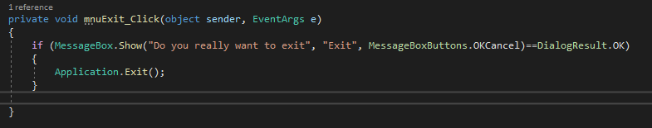
Coding for the exit button

Slide 13
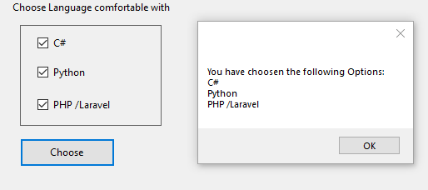
Coding for checkbox
Will an interface to look as what we have below then write the code to give us the output on a message box as shown.

Slide 14
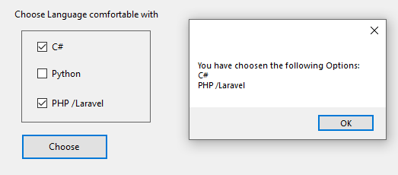
Coding for checkbox

Slide 15
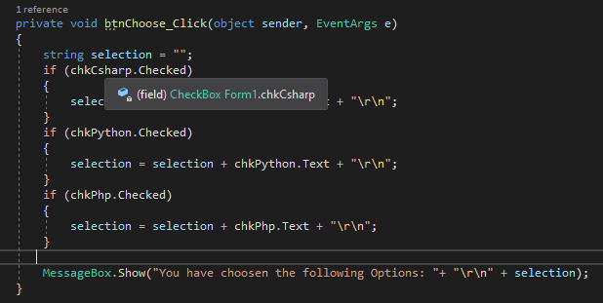
Code to give the output shown

Slide 16
Coding for radio buttons
We will add radio buttons as shown in the image below, to add the radio buttons go to the tool box, locate the radio button and double click on it or drag on the form, select the radio button and change the text property from the property window, so that we will have Mpesa, Cash and Visa Card. The same should happen for the name property.

Slide 17
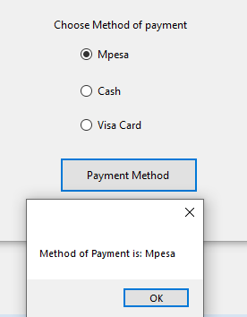
Coding for radio buttons
Will give the radio buttons name i.e. rbopesa, rboCash and rboVisa

Slide 18
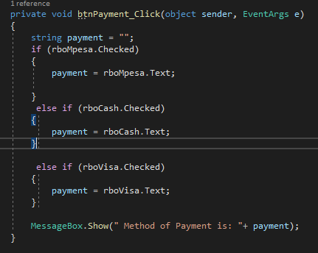
Code..

